Slide 1
Data Mining 47717 ISCDB Milestone 2

Slide 2
Research topics
Research supreme court judges' tendencies
Tendency for judges to team up together
Tendencies by professional and personal characteristics
Tendencies by lawyers' identity: sectors, genders
Trends in ISC decisions: case duration, case weight

Slide 3
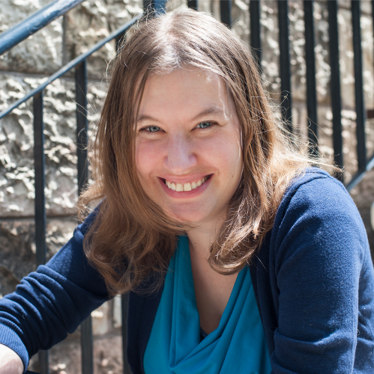
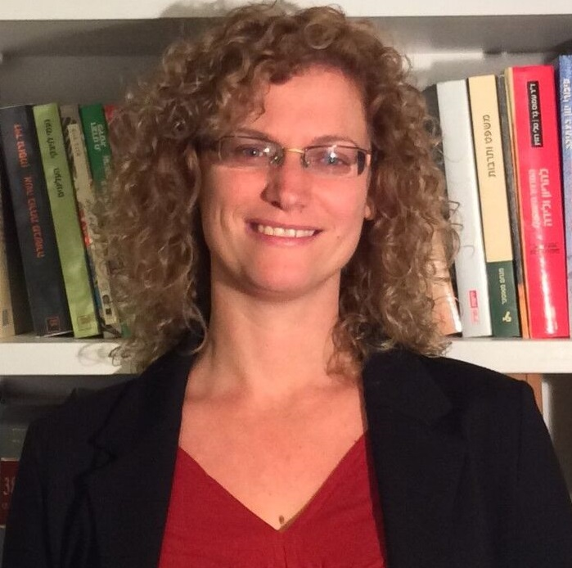
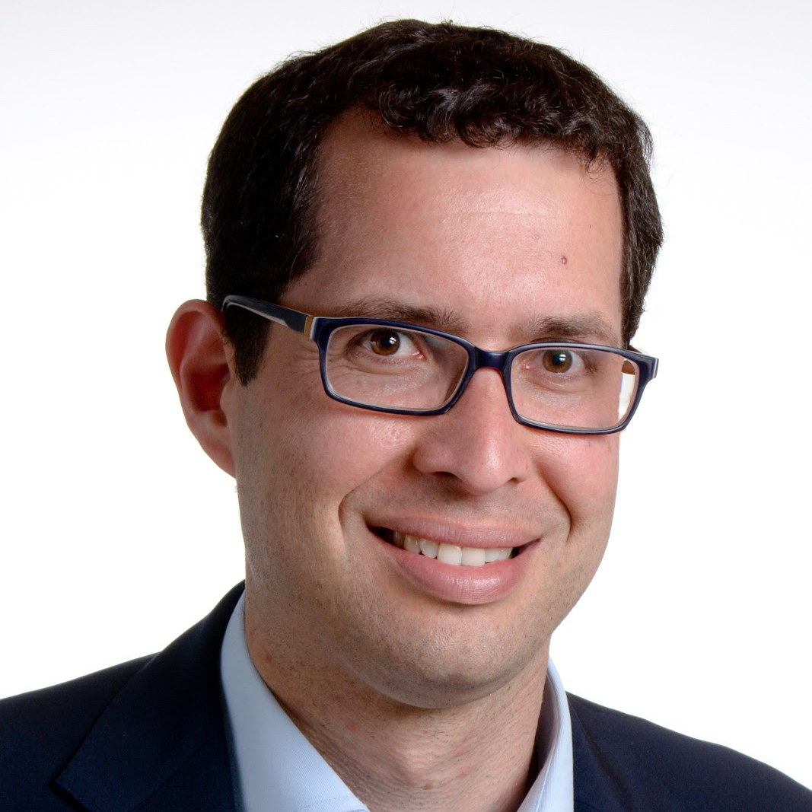
The friends we made along the way
Using a dataset already used by academic researchers, we wanted to extract real insights with real academic values.
Prof. Dafna Shahaf Compuer sciences professor
Course 47717 teacher
Prof. Keren Weinshall Law Faculty Vice Dean
Empirical legal researcher and the creator of the ISCDB
Prof. Yehonatan Givati Law Professor
Published a research about how supreme court judges team up

Slide 4
Dataset structure
Gender and ethnicity enrichments
Combining our dataset with another dataset from the LMS, we managed to determine whether the case parties are Jewish or Arab, male or female
3
Enrichments for cases and judges
Scraping for verdict word count, calculating judge seniority, case duration and more
2
Israeli Supreme Court Database
We started with the ISCDB which contains some data about decisions made by the Isreali Supreme Court between 2012-2018
1

Slide 5
Milestone Insights
Let’s see what we’ve got so far and what’s still waiting down the road

Slide 6
Tendency for judges to team up
1
Judges community analysis

Slide 7
Judges tendency to team up together
Background: The way judges are allocated to cases in the Israeli system is not random
Hypothesis: Judges tends to team up by either professional considerations or by strategical considerations
Method:
Calculate how many times each pair of judges appear together, out of their total appearances
Clean the data
Analyze the data

Slide 8
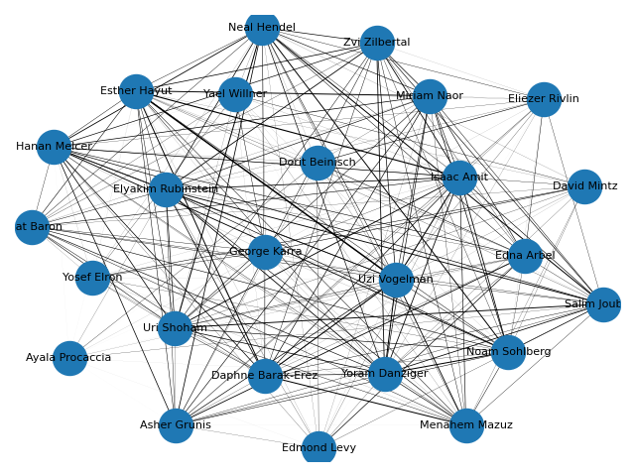
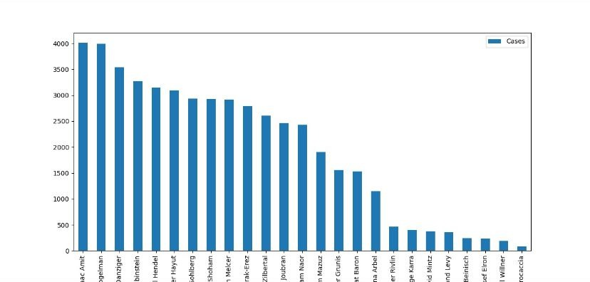
Judges community analysis
Before cleaning up the communities were messy.

Slide 9
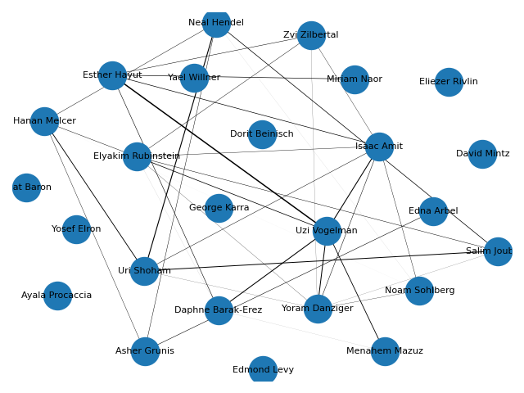
Judges community analysis
Cleaning the community graph:
Without the judges which appeared very little (very low ratio)

Slide 10
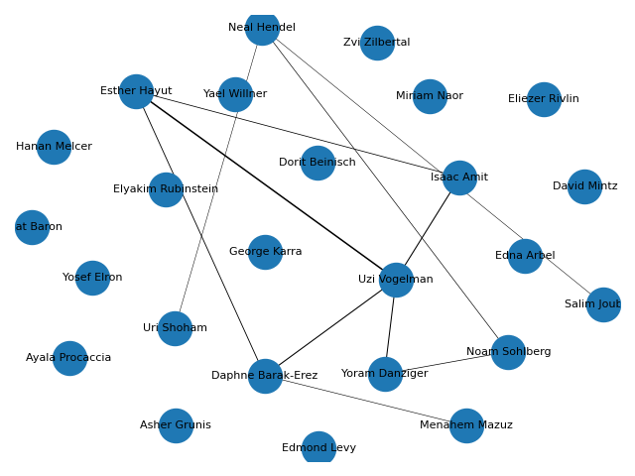
Judges community analysis
Cleaning the community graph:
Without the judges which appeared very little (very low ratio)
With a higher coupling ratio

Slide 11
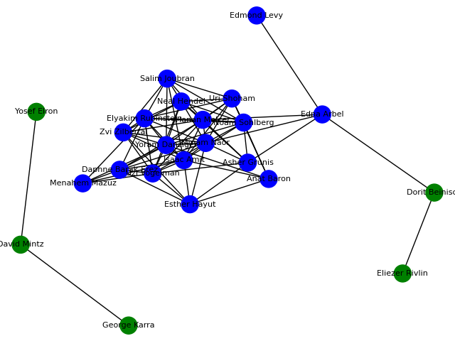
Judges community analysis: Grivan-Newman
Using the Grivan-Newman algorithm

Slide 12
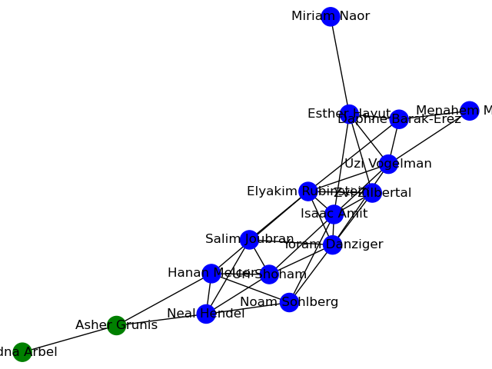
Judges community analysis: Grivan-Newman
Using the Grivan-Newman algorithm
Without the judges which appeared very little (very low ratio)

Slide 13
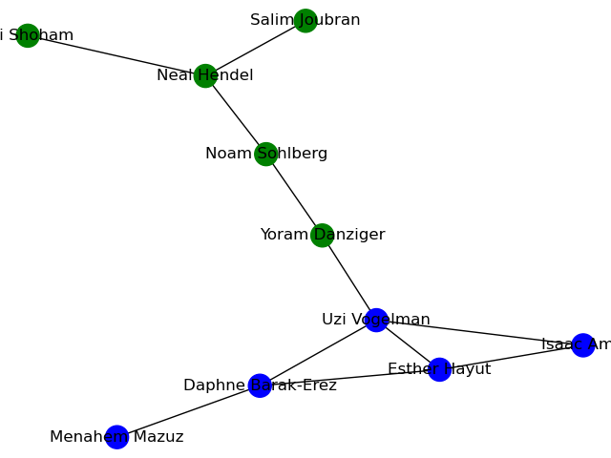
Judges community analysis
Using the Grivan-Newman algorithm
Without the judges which appeared very little (very low ratio)
With a higher coupling ratio

Slide 14
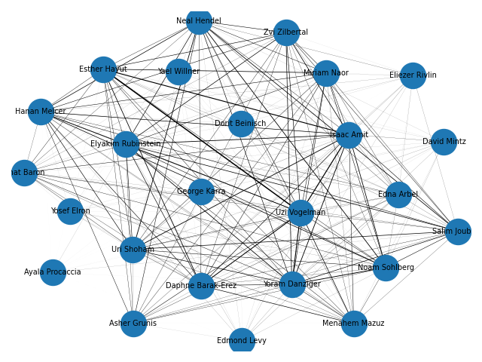
Judges community analysis: Path distances
Calculating paths distances:
At first, we couldn’t produce a graph due because there were some missing connections

Slide 15
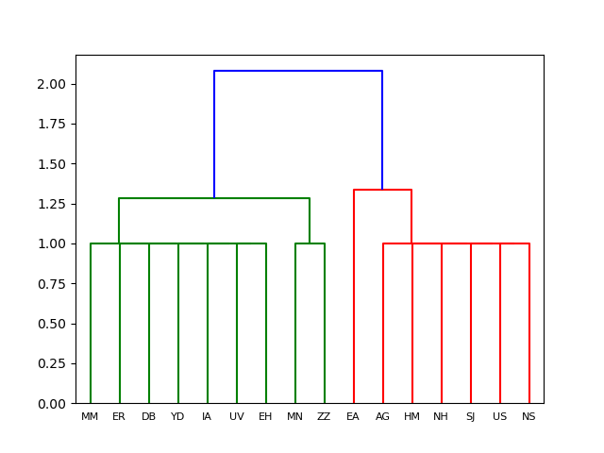
Judges community analysis: Path distances
Calculating paths distances
Without the judges which appeared very little (very low ratio), we managed to produce a graph

Slide 16
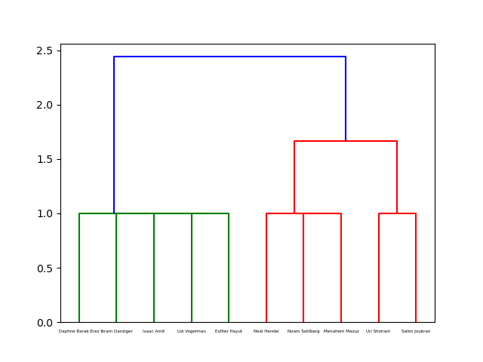
Judges community analysis: Path distances
Calculating paths distances
Without the judges which appeared very little (very low ratio)
With a higher coupling ratio

Slide 17
Judges community analysis: Insights
Eventually, we’ve managed to indicate 2 teams:
The first team consists of Daphne Barak-Erez, Isaac Amit, Uzi Vogelman and Ester Hayut
A second team consists of Neal Hendel, Noam Sohlberg, Uri Shoham and Salim Joubran
Judges which can be found in both teams, depending on the algorithm we chose: Menahem Mazuz and Yoram Danziger

Slide 18
Judges community analysis: The first team
The first team: Barak-Erez, Amit, Vogelman and Hayut.
Barak-Erez, Vogelman and Hayut are considered liberal and activist judges while Amit is relatively conservative.
In criminal cases, all are tending to impose severe punishments.
In Prof. Givati research,
he addressed to a team consists of Barak-Erez, Hayut, Vogelman and Mazuz

Slide 19
Judges community analysis: The second team
The second team: Hendel, Sohlberg, Joubran and Shoham.
Sohlberg, Hendel and Shoham are religious.
Sohlberg is considered conservative, Hendel and Shoham are neutral and Joubran is considered liberal.
In criminal appeals, all judges are tending to be critical against the prosecution and to acquit.
In Prof. Givati research,
he addressed to a team consists of Sohlberg and Hendel

Slide 20
Judges community analysis: Mazuz and Danziger
Both Mazuz and Danziger were found in both teams in the different algorithms.
Both are considered liberal and activist judges.
In criminal cases, Both tends to acquit.

Slide 21
Tendencies in judges decisions
2
How different criteria affects judicial decisions

Slide 22
Tendencies in judicial decisions
Background:
Hypothesis: Some characteristics of the judges and \ or the lawyers are affecting the judicial decisions regardless of the legal question of the case
Method:
Enrich the data with more details regarding the judges and lawyers: seniority, ethnicity, gender, background
Analyze the data and look for correlations in judicial decisions

Slide 23
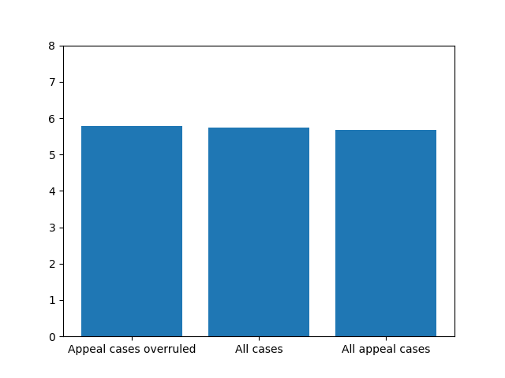
Tendencies in judicial decisions: Average judges seniority by case
Hypothesis: The longer the judge is serving in the ISC, the higher the chances of the judge to change the previous ruling
Results: No correlation between seniority and judicial desicions

Slide 24
Tendencies in judicial decisions: Judges professional background
Hypothesis: Judges coming with different backgrounds and expertise rule differently
Status:
✔ Data enriched for each judge
→ Data and correlations analysis

Slide 25
Tendencies in judicial decisions: Lawyers identity
Does the lawyer ethnicity affect ruling?
By Jewish v. Arabs lawyers
By legal issue
By judge ethnicity
Does the lawyer gender affect ruling?
By male v. female lawyers
By legal issue
By judge gender
Status:
✔ Data enriched using data from the LMS
✔ Data enrichment passed sanity checks
→ Data and correlations analysis

Slide 26
Pattern and correlation detection
3
Are there any patterns or correlations to detect?

Slide 27
Predictable trends
Background: The supreme court hears around 4,000 cases in panels (3 judges or more). While some decisions take days, others take years.
Hypothesis: The efficiency of the SC changes between different case types and case “weights” (hot potatoes), in which judges tends to avoid hard decisions
Method:
Enrich the data: verdict word count, case duration
Create a “case weight” metric
Analyze the data and look for correlations in case duration and in case weights
Status:
✔ Data enriched using crawling and calculations
✔ Data enrichment passed sanity checks
→ Data and correlations analysis

Slide 28
Thanks!
Any questions?

